Slide 1


Slide 2

The Team!
Mark Denina
Alexis Cruz Aboytes
@mdenina1
@ChicoQuemador1
Link to repository:
https://github.com/ChicoQuemador1/HanaBudget
Link to YouTube:
https://www.youtube.com/@_AMplify.

Slide 3
General Problem
"In this project, we aim to develop an expense tracker app designed to help users effortlessly track their spending and manage their budgets. Unlike most expense tracking apps, which can be complex and intimidating, our app will prioritize ease of use without sacrificing functionality. Key features will include categorized expense tracking, budget goal setting, and visual reporting. Our objective is to create an intuitive interface that makes personal finance management accessible and straightforward for everyone."

Slide 4
General Requirements
Inputs
Functional Requirements
User Registration Details:
Name, email, and password for account creation.
Expense Entry:
Amount, category (e.g., groceries, utilities, entertainment), date, and optional notes.
Budget Setting:
Total budget amount, budget categories, and time frame (e.g., monthly, weekly).
The app should allow users to easily input their expenses and categorize them.
Users should be able to set up and adjust their budget goals.
The app should provide clear, visual reports and analytics to help users understand their spending habits and financial status.
The interface should be intuitive, with a focus on simplifying the user experience to encourage regular use.
Outputs
Non-Functional Requirements
Account Confirmation:
Confirmation of successful registration and subsequent login authentication.
Expense Tracking Summary:
Display of expenses sorted by category, time, and amount.
Budget Overview:
Visual representation of budget allocation and remaining balance per category.
Reports and Analytics:
Graphical reports showing spending trends, budget compliance, and financial insights.
The app must be secure, ensuring user data protection and privacy.
It should be responsive and reliable, with minimal downtime.
The design should be scalable to accommodate an increasing number of users and potential feature expansions.

Slide 5
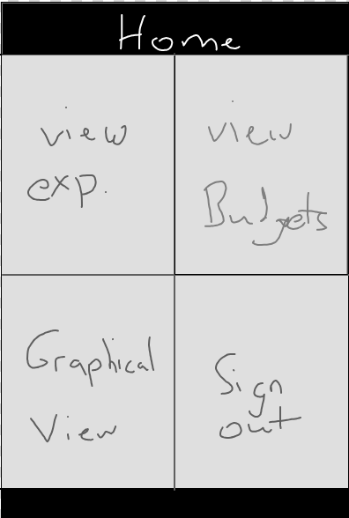
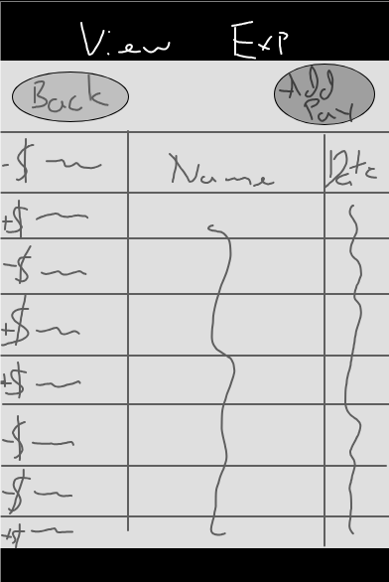
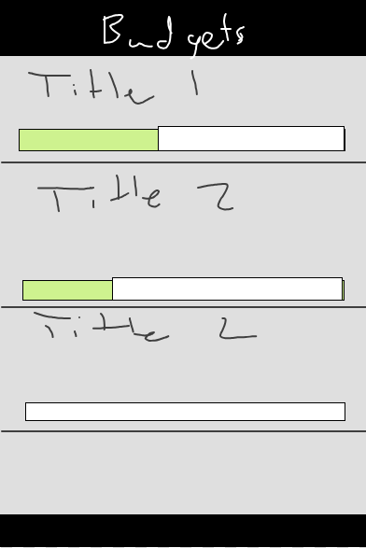
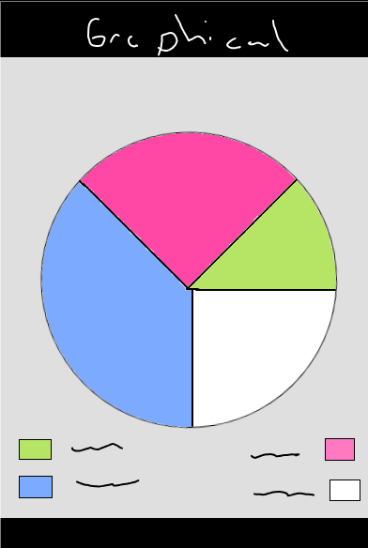
Initial UI Wireframe

Slide 6

Product infographic
Visuals
Features
Showcase the design of your product
What makes you product unique?
Price
Users
Share the cost and price with investors
Speak about the target audience
Availability
Updates
When is the product expected to be ready?
Do you plan on updating it?

Slide 7
Contents of this template
You can delete this slide when you’re done editing the presentation
Fonts | To view this template correctly in PowerPoint, download and install the fonts we used
Used and alternative resources | An assortment of graphic resources that are suitable for use in this presentation
Thanks slide | You must keep it so that proper credits for our design are given
Colors | All the colors used in this presentation
Icons and infographic resources | These can be used in the template, and their size and color can be edited
Editable presentation theme | You can edit the master slides easily. For more info, click here
For more info: SLIDESGO | BLOG | FAQs
You can visit our sister projects: FREEPIK | FLATICON | STORYSET | WEPIK | VIDEVO

Slide 8
Table of contents
01
02
03
04
05
06
Introduction
Problem & solution
Market opportunity
Product demo
Team & timeline
Financial & metrics

Slide 9
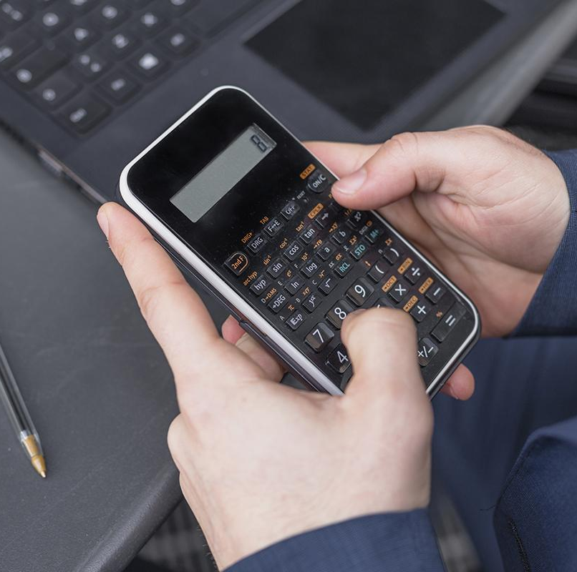
01
Introduction

Slide 10
Six recommendations
Keep it simple
Use visuals
Keep it short
Structure your pitch deck clearly and make sure all the important points are easy to understand
Incorporate visuals or graphics to illustrate your message and keep the audience engaged
A good pitch deck should be concise and clear; avoid trying to cram in too much information
Make it memorable
Test & iterate
Main points
Include impactful stories, statistics, or facts that will help your audience remember your
message afterwards
Practice presenting your deck beforehand with friends or colleagues for feedback, then use this input to refine it further
A pitch deck is an overview of your business; focus on key points that get the most important ideas across

Slide 11
333,000
9h 55m 23s
386,000 km
Users bought our product
Estimated delivery time per unit
Avg. distance travelled by logistics team

Slide 12
78,300,000
Number of users analyzed in our market research

Slide 13
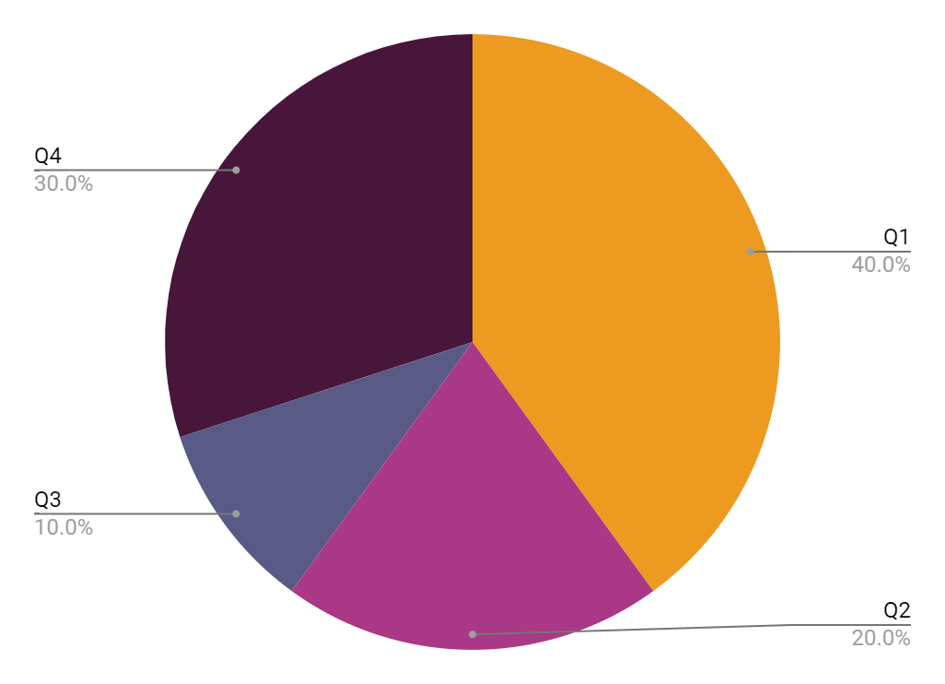
Revenue by quarter
Q1
Q2
Q3
Q4
January - March
April - June
July - September
October - December
Follow the link in the graph to modify its data and then paste the new one here. For more info, click here

Slide 14
Competition comparison
 | Features | Value | Pricing | Trial | Competence
Company A | Fuel economy | Special offers | $23,000 | No | Low
Company B | Design | Reliability | $27,000 | No | Low
Company C | Performance | Repairs | $30,000 | Yes | High
Company D | Safety features | Marketing | $24,000 | No | High
Company E | Technology | Customers | $32,000 | Yes | Low
Company F | Comfort | Best prices | $15,000 | Yes | High

Slide 15
Timeline of your presentation
01
02
03
04
Provide a brief overview of the pitch deck's content
Engage the audience with a compelling introduction
Identify the customer's pain points and challenges
Describe how your product or service can solve the problem
05
06
07
08
Highlight the unique value proposition and benefits of your specific solution
Analyze the target market size and competition briefly
Explain your financial needs and briefly outline your funding allocation
End with a clear and concise call to action

Slide 16
Organizational chart
John Doe
CEO
Jane Smith
Department Head
Mark Willson
Department Head
Emma Miller
Manager
Richard Taylor
Manager
Sarah Williams
Manager
Brian Clark
Employee
Michelle García
Employee
James Scott
Employee
William Young
Employee
Alan Turner
Employee

Slide 17
Market size overview
265 k
125 k
74 k
Outer circle
Middle circle
Inner circle
Include the total size of the market, which represents the entire potential customer base for the product or service
Identify the target market for the product or service. This could be based on factors such as geography, or specific needs
Indicate the current market size, which represents the portion of the target market that the company has successfully captured

Slide 18
Roadmap infographic
 |  |  | Phase 1 |  |  | Phase 2 |  |  | Phase 3 |  |  | Phase 4
Initiative | % Done | Objective | Jan | Feb | Mar | Apr | May | Jun | Jul | Aug | Sep | Oct | Nov | Dec
Understanding | 20% | Analyze and understand the needs of your target audience
Conduct research | 10% | Research existing products in the industry
Brainstorm ideas | 60% | Generate ideas based on user feedback
Develop a prototype | 40% | Create a basic version of the product to show investors
Test for usability | 80% | Put the prototype through rigorous testing processes

Slide 19
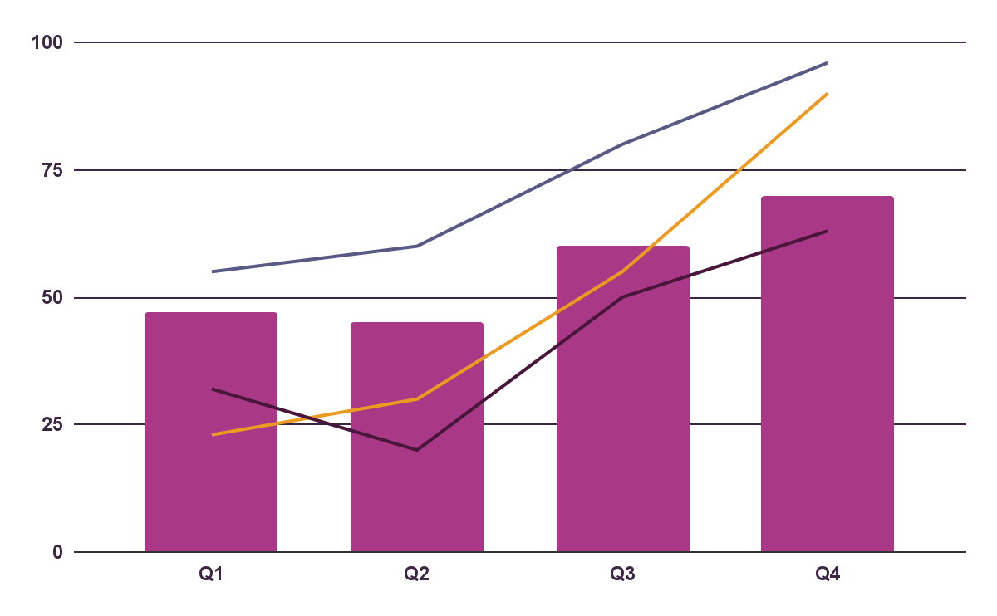
KPI dashboard
$4,000,000
$100,000
$5,000
Revenue
General costs
Profit
Product | Units | Revenue | Returns
Item 1 | 500 | 2,000,000 | 40
Item 2 | 1,000 | 50,750 | 10
Item 3 | 250 | 1,500,000 | 300
Item 4 | 500 | 2,000,000 | 40
Item 5 | 1,000 | 50,750 | 10
Follow the link in the graph to modify its data and then paste the new one here. For more info, click here

Slide 20
Thanks!
Do you have any questions?
youremail@freepik.com
+34 654 321 432
yourwebsite.com
Please keep this slide for attribution

Slide 21
Icon pack

Slide 22
Alternative resources
Here’s an assortment of alternative resources whose style fits the one of this template:
Vectors
Technology concept landing page template
Icons big data background

Slide 23
Resources
Did you like the resources on this template? Get them for free at our other websites:
Photos
Top view woman typing on laptop
Businessman on a terrace
Vectors
Flat design data driven illustration I
Flat design data driven illustration II
Icons pack
Icon Pack: Money | Filled

